Slide 1
Syllabus
Unit 1
Introduction: Overview of DBMS fundamentals – Overview of Relational Databases and Keys. Relational Data Model: Structure of relational databases – Database schema. Database Design: Overview of the design process - The E-R Models – Constraints - Removing Redundant Attributes in Entity Sets - E-R Diagrams - Reduction to Relational Schemas - Entity Relationship Design Issues - Extended E-R Features – Alternative E-R Notations.
Unit 2
Relational Database Design: Features of Good Relational Designs - Atomic Domains and 1NF - Decomposition using Functional Dependencies: 2NF, 3NF, BCNF and Higher Normal Forms. Functional Dependency Theory - Algorithm for Decomposition – Decomposition using multi-valued dependency: 4NF and 4NF decomposition. Database design process and its issues. SQL: review of SQL – Intermediate SQL – Advanced SQL.
Unit 3
File Organization – Indexing and Hashing - Storage Structure - Transactions: Transaction concepts- ACID Properties – Serializability – Recoverable schedules, Cascade less schedules. Need for Concurrency -Locking Protocols- Deadlock and Recovery. Overview and applications of NoSQL databases – MongoDB, Neo4j/GraphDB.
Textbook(s)
Silberschatz A, Korth HF, Sudharshan S. “Database System Concepts”. Seventh Edition, TMH publishing company limited; 2019.

Slide 2
Storage Structure-File Organization

Slide 3
1. File Organization
Definition: The way data is stored in files on disk. Goal: Efficient retrieval and update of records.
TYPES OF FILE ORGANIZATION
Type | Description
Sequential File Organization | Records are stored in sequential order (based on primary key). Efficient for large sequential processing but inefficient for random access or frequent updates.
Heap (Unordered) File Organization | Records stored randomly as they arrive. Fast insertion but slow search (requires scanning).
Clustered File Organization | Related records are grouped together in the same block. Improves access for related queries.

Slide 4
2. Indexing
Definition: A data structure that improves the speed of data retrieval on a database table. Works like a book index: key → location of record.
Types of Indexes
1. Primary Index – Built on the primary key of a file; records are sorted by the key. 2. Secondary Index – Built on non-primary attributes, providing additional access paths. 3. Clustering Index – Built on a non-key attribute to group records with the same attribute value.
Multilevel Index
Index of indexes in a tree-like structure, reducing search time logarithmically.

Slide 5
B+ Tree Index
Balanced tree structure with all records at leaf nodes. Internal nodes store only keys, efficient for range queries.
A B+ tree is a self-balancing tree data structure widely used in database management systems (DBMS) for efficient indexing. Its design is optimized for disk-based storage, minimizing disk I/O operations and providing fast access to data.

Slide 6
Key Characteristics of B+ Trees:
All data is stored in leaf nodes:
Unlike B-trees, internal nodes in a B+ tree only contain key values that act as guides to navigate the tree, not actual data records. The data records (or pointers to them) reside exclusively in the leaf nodes.
Leaf nodes are linked:
All leaf nodes are connected sequentially using a linked list. This enables efficient range queries, allowing traversal of the linked list to retrieve data within a specified range without having to traverse the entire tree repeatedly.
Balanced structure:
All leaf nodes are at the same level, ensuring that the search time for any record is consistent and logarithmic (𝑂(log𝑛)
Higher fanout:
B+ trees typically have a higher fanout (more children per node) compared to B-trees, leading to shallower trees and fewer disk reads for data retrieval.

Slide 7
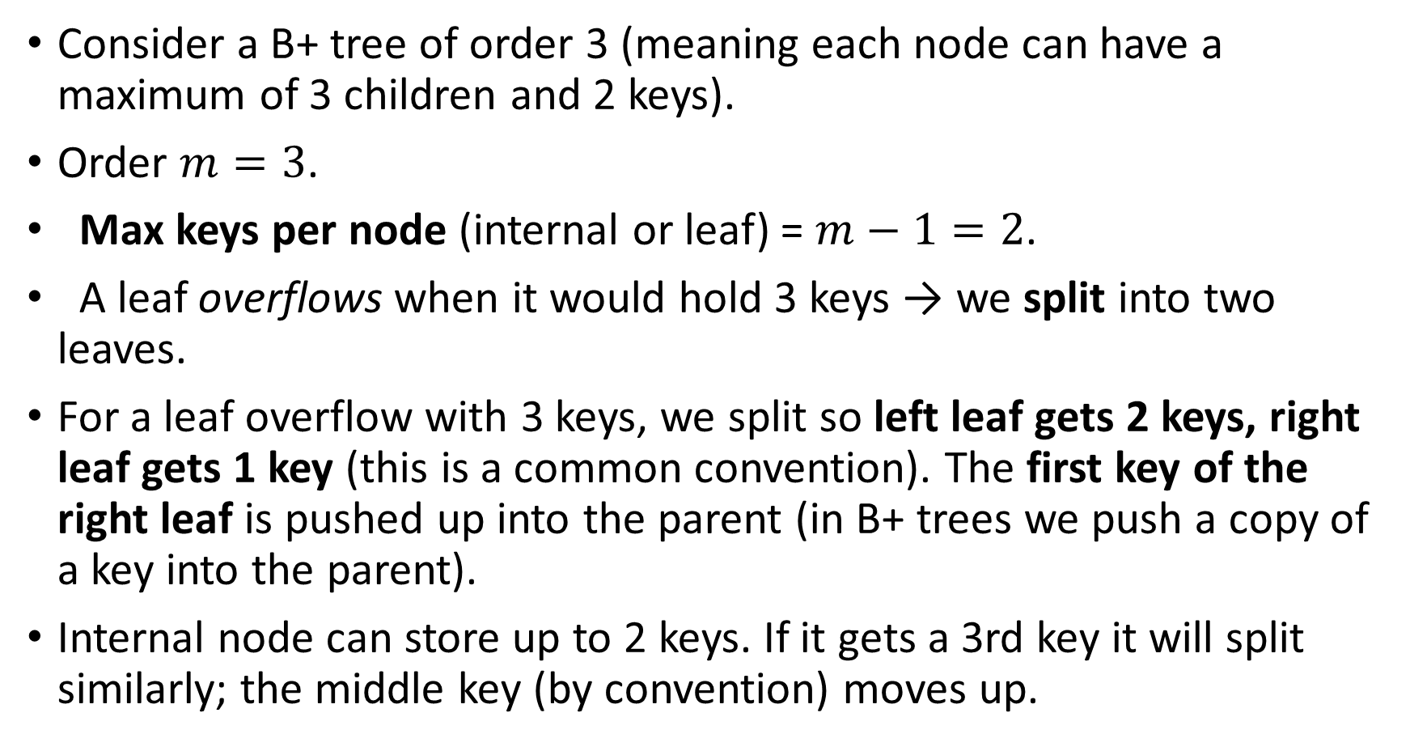
Consider a B+ tree of order 3 (meaning each node can have a maximum of 3 children and 2 keys).
Order $m=3$.
Max keys per node (internal or leaf) = $m−1=2$.
A leaf overflows when it would hold 3 keys → we split into two leaves.
For a leaf overflow with 3 keys, we split so left leaf gets 2 keys, right leaf gets 1 key (this is a common convention). The first key of the right leaf is pushed up into the parent (in B+ trees we push a copy of a key into the parent).
Internal node can store up to 2 keys. If it gets a 3rd key it will split similarly; the middle key (by convention) moves up.

Slide 8
Consider a B+ tree of order 3 (meaning each node can have a maximum of 3 children and 2 keys).
Insertion Example:
Initial State: An empty B+ tree.
Insert 10, 20, 30: These values are inserted into the first leaf node: [10, 20, 30].
Insert 40: The leaf node is full. It splits into two leaf nodes: [10, 20] and [30, 40]. The key 30 is promoted to the parent (root) node to act as a separator:
[30]
/ \
[10, 20] [30, 40] In B+ Trees, we promote the smallest key of the new right node.

Slide 9
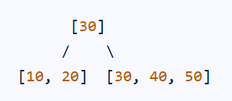
Insert 50: The value 50 is inserted into the leaf node containing [30, 40], resulting in [30, 40, 50].
Searching Example:
To search for the value 40 in the above B+ tree:
Start at the root node [30]. Since 40 > 30, navigate to the right child.
Reach the leaf node [30, 40, 50]
Perform a sequential search within this leaf node to find 40

Slide 10
Example 2
Step 1: Build base tree (before inserting 30)
Let’s first insert: 10, 20, 40, 50, 60
We already know this pattern from earlier examples.
Insert 10, 20 →
[10, 20]
Insert 40 → overflow → split leaf → promote 40
[40]
/ \
[10,20] [40]

Slide 11
Insert 50 → Goes to right leaf [40] → [40, 50]
[40]
/ \
[10,20] [40,50]
Insert 60 → Right leaf [40,50] → [40,50,60] → overflow → split into [40] and [50,60] → promote 50
[40, 50]
/ | \
[10,20] [40] [50,60]

Slide 12
Step 2: Now insert 30
We start at root [40, 50].
30 < 40 → go to left child [10,20]
Insert 30 there → [10,20,30] → overflow!
Now we must split that leaf.
Splitting [10,20,30]:
Left leaf = [10,20]
Right leaf = [30]
Promote the first key of the right leaf (30) to parent.
So we insert 30 into parent (root).

Slide 13
Step 3: Insert promoted key (30) into parent
Root before promotion = [40, 50]
Insert promoted key 30 → [30, 40, 50] → overflow again (3 keys). We now need to split the root.
Split root into:
Left internal: [30]
Right internal: [50]
Middle key (40) becomes new root.
Step 4: Final tree after all splitting
[40] ← new root
/ \
[30] [50] ← internal nodes
/ \ / \
[10,20] [30] [40] [50,60] ← leaf nodes

Slide 14
Why B+ Trees Are Used in DBMS
1. Efficient Searching
Search is logarithmic time, i.e., O(log n).
Database systems can find a record by traversing only a few levels.
2. Balanced Structure
Tree remains balanced after insertions and deletions.
Ensures consistent performance for all operations.
3. Minimized Disk I/O
Each node corresponds to a disk block (page).
High fan-out (branching factor) reduces tree height, hence fewer disk reads.
4. Supports Range Queries
Since leaf nodes are linked, range queries like WHERE age BETWEEN 20 AND 40 can be executed efficiently by scanning linked leaves.
5. Used for Both Primary and Secondary Indexing
Primary index: When key field is unique (e.g., RollNo, EmployeeID).
Secondary index: When indexing non-key attributes.

Slide 15
Use in DBMS
DBMS Function | Role of B+ Tree
Indexing | Most common index structure (used in MySQL, Oracle, PostgreSQL)
Clustering | Leaf nodes store actual record pointers (clustered index)
Query Optimization | Reduces need for full table scans
File System | Used in NTFS, HFS+, and other file systems

Slide 16
Example in SQL
When you create an index:
CREATE INDEX idx_salary ON employees(salary);
➡ The DBMS internally creates a B+ Tree structure on the salary column. This index helps speed up queries like:
SELECT * FROM employees WHERE salary BETWEEN 50000 AND 80000;

Slide 17
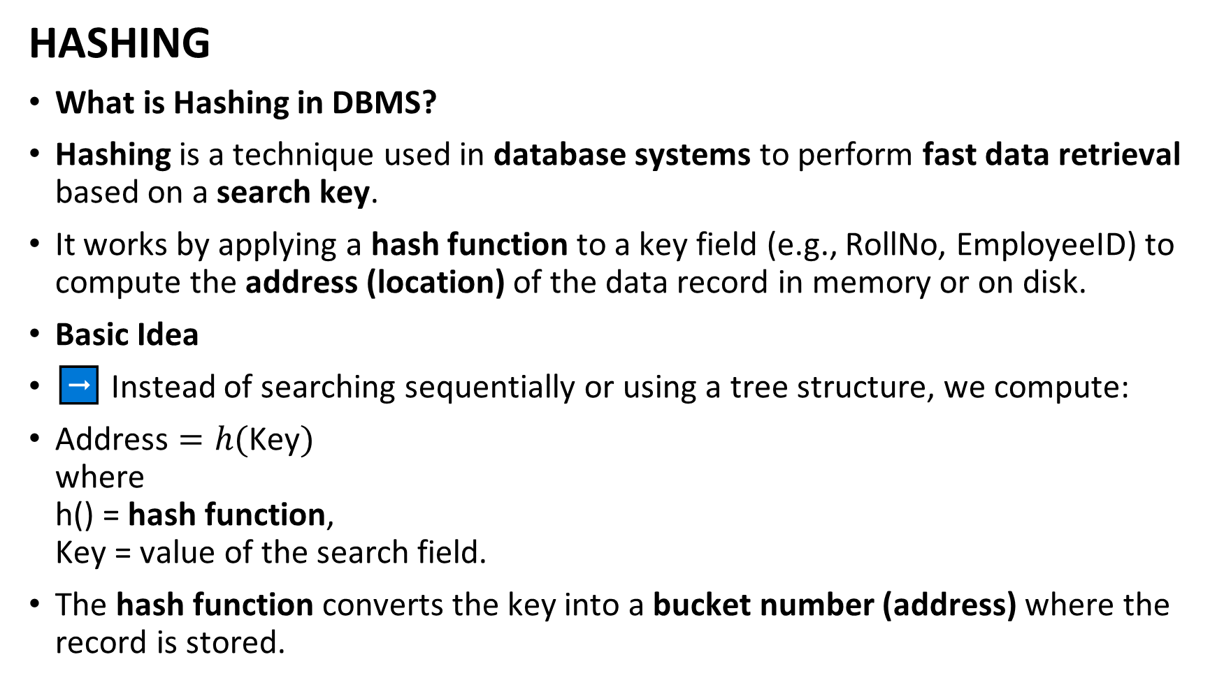
HASHING
What is Hashing in DBMS?
Hashing is a technique used in database systems to perform fast data retrieval based on a search key.
It works by applying a hash function to a key field (e.g., RollNo, EmployeeID) to compute the address (location) of the data record in memory or on disk.
Basic Idea
➡️ Instead of searching sequentially or using a tree structure, we compute:
$\text{Address}=h(\text{Key})$ where h() = hash function, Key = value of the search field.
The hash function converts the key into a bucket number (address) where the record is stored.

Slide 18
Terminology
Term | Meaning
Hash function (h) | Function that maps a key to a hash value or bucket number
Bucket | A storage unit (block) that holds one or more records
Slot | Space for a single record inside a bucket
Collision | When two keys hash to the same bucket
Overflow area | Extra storage for records that cause collisions

Slide 19
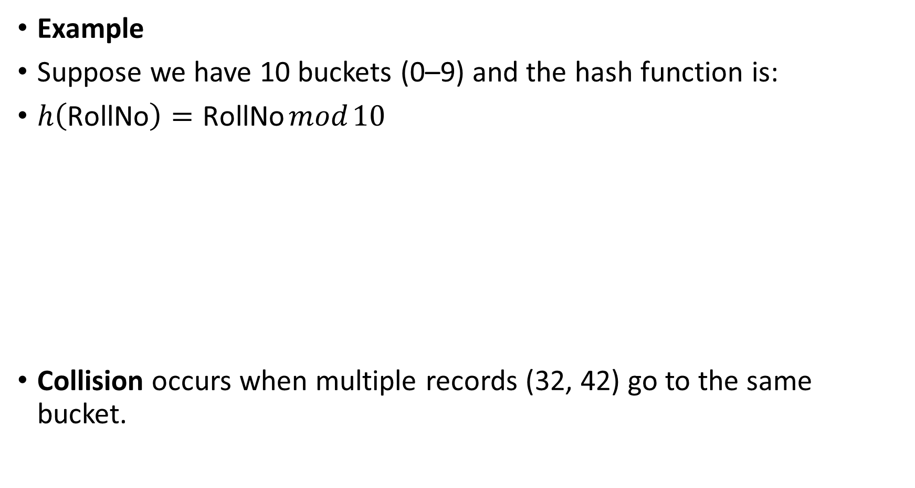
Example
Suppose we have 10 buckets (0–9) and the hash function is:
$h\left(\text{RollNo}\right)=\text{RollNo} mod 10$
Collision occurs when multiple records (32, 42) go to the same bucket.
RollNo | h(RollNo) | Stored in Bucket
25 | 5 | 5
32 | 2 | 2
42 | 2 | 2 (Collision with RollNo 32!)
58 | 8 | 8

Slide 20
Handling Collisions
1. Open Hashing (Separate Chaining)
Each bucket has a linked list of records with the same hash value.
When a collision occurs, the new record is added to the list.
Bucket 2 → [32] → [42] → [52]
2. Closed Hashing (Open Addressing)
If the target bucket is full, probe the next bucket using
Linear probing: next bucket (h(key) + 1) mod n
Quadratic probing: (h(key) + i²) mod n
Double hashing: use a second hash function

Slide 21
Types of Hashing in DBMS
Type | Description
Static Hashing | Number of buckets is fixed. Collisions handled via overflow area.
Dynamic Hashing | Number of buckets can grow or shrink as database grows. Examples: Extendible Hashing, Linear Hashing.

Slide 22
Static Hashing
The hash function and bucket count remain constant.
Overflow occurs when too many records map to the same bucket.
Suitable for small, stable datasets.
Problems:
Performance drops as data grows.
Buckets overflow frequently.

Slide 23
Dynamic Hashing
Used in modern DBMS to handle growing data efficiently.
➤ Extendible Hashing
Uses a directory of pointers to buckets.
Directory size doubles when buckets overflow.
Hash values are represented in binary.

Slide 24
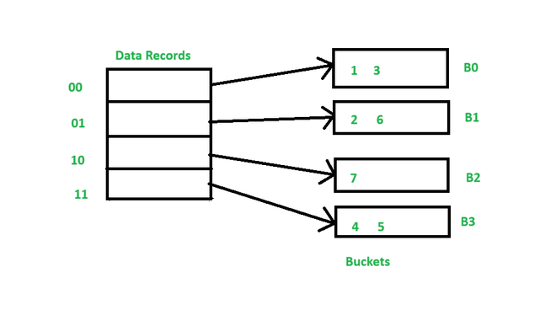
Consider the following table which contain key into bucket based on their hash address prefix. In the above table, the last two bits of 1 and 3 are 00. So, it will go into bucket B0. The last two bits of 2 and 6 are 01. So, it will go into bucket B1. The last bit of 7 is 10. So, it will go into bucket B2. The last two bits of 4 and 5 are 11. So, they will go into B3.
Key | Hash Address
1 | 10000
2 | 10101
3 | 11000
4 | 10011
5 | 11011
6 | 11001
7 | 10110

Slide 25
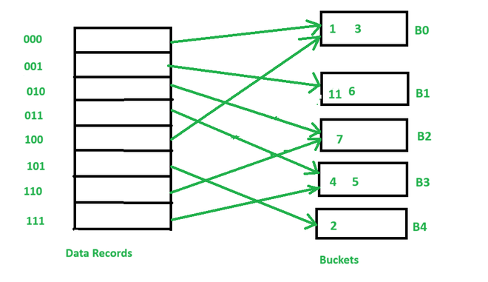
Now, to insert key 11 with hash address 10001 into the above structure follow the steps:-
Since, hash address of the bucket is 10001. It will go into bucket B1. But B1 bucket is already filled, so it will get split.
Three bits of 11 and 6 are 001. So, they will go into bucket B1. And last three bits of 2 are 101. So, it will go into B4.
Keys 1 and 3 are still in bucket B0. The record B0 is pointed by 000 and 100 entry because last two bits of both the entry are 00.
Key 7 is still in bucket B2. The record B2 is pointed by 010 and 110 entry because last two bits of both the entry are 10.
Key 4 and 5 are still in bucket B3. The record B3 is pointed by 111 and 011 entry because last two bits of both the entry are 11.

Slide 26
⚡Advantages of Hashing
✅ Very fast for equality search (e.g., WHERE RollNo = 25) ✅ O(1) average search time ✅ Simple implementation ✅ Efficient for large datasets stored on disk
⚠️ Limitations
❌ Not suitable for range queries (e.g., salary BETWEEN 30000 AND 40000) ❌ Collisions can still cause overhead ❌ Hash function must distribute keys uniformly

Slide 27
💾 Use of Hashing in DBMS
Used in Hash Indexes (e.g., MySQL MEMORY engine)
Used in Join operations (Hash Join)
Used in Partitioning large tables (hash partitioning)
Used in Buffer management (hash tables to locate pages)

Slide 28
📘 Hashing vs. Indexing
Feature | Hashing | Indexing (B+ Tree)
Query Type | Equality search | Range + equality
Structure | Hash table | Tree (hierarchical)
Order | Unordered | Sorted order
Performance | O(1) average | O(log n)
Best for | Exact key lookups | Range scans, sorting

